Slide 1
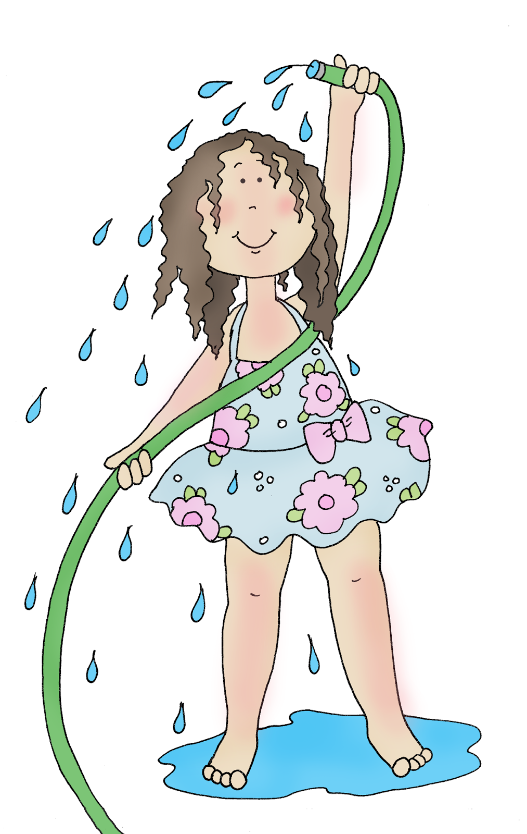
HOW TO ESTIMATE YOUR OWN WATER FOOTPRINT AT HOME.
International Day of Women and Girls in Science
Sunday 11th of February
2024

Slide 2
Hello, Water Explorers!
Did you know that water is one of the most precious things on our planet? Just like the air that we breathe, water is vital for life! It's not just for drinking. Water has a super important job in everything around us!
Our water footprint is the mark we leave behind, based on how much water we use every day. From brushing our teeth to enjoying a tasty snack, everything we do leaves a little footprint!
Taking care of our water is super important. By using water wisely, we help protect the planet and make sure there's enough clean water for everyone and everything around the world.
So, get ready to embark on our water footprint adventure, where you will be guiding your family to figure out how much water you consume. Together, we'll learn how small changes can make a big difference in keeping our watery world happy and healthy.
Splash on, Water Explorers!

Slide 3
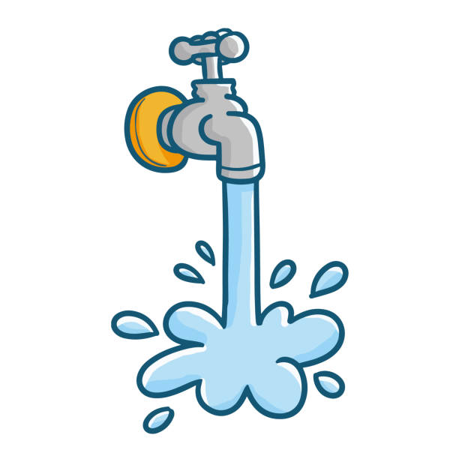
To help you estimate how much water you consume at home, you first need to collect the
following materials:
The toilet, kitchen and laundry consumption cards, printed and ready to use.
Something to write (could be colorful pencils or anything at hand).
A timer (could be a phone, a clock, or any other device to record time).
Your whole family cooperating together for a full day, mimicking everything you do to measure your entire water consumption. ☺
Hang each one of the consumption cards on the walls of each one of the rooms (toilet, kitchen and laundry). Add a pen next to them so that is easy for everyone to write how much water you consume.
For as many days as you can, every time you or any of your family members use water, all of you have to keep a good track of it! You can count with your timer how long was your shower on, how much time was the tap on the kitchen sink open while doing the dishes or brushing your teeth, or you can add crosses every time you flush the toilet, use the washing machine, or use the dishwasher. Keep all your numbers as accurate as you can!
The next day, ask your parents for help to sum up your measurements, and go to www.cvonessen.com/teaching-outreach/waterfootprint.html to check your water consumption at home! If your numbers are above averages, we will give you some tips on how to keep the water consumption down.
I hope it was fun to estimate your water footprint! Well done! ☺

Slide 4
#Shower | Time [min]
TOILET
#Sink | Time [min]
#Sink | Time [min]
# of toilet flushes (add a cross every time you flush)
Total: _______ min.
Total: _______ flushes.
Total: _______ min.

Slide 5
#Shower | Time [min]
TOILET
#Sink | Time [min]
#Sink | Time [min]
# of toilet flushes (add a cross every time you flush)
Total: _______ min.
Total: _______ flushes.
Total: _______ min.

Slide 6
K
I
T
C
H
E
N
# dishwashing cycles (add a cross every time you use it)
Use of sink [min]
Use of sink [min]
Total: _______ min.
Total: _______ cycles.

Slide 7
L
A
U
N
D
R
Y
# washing cycles (add a cross every time you use it)
Use of sink [min]
Use of sink [min]
Total: _______ min.
Total: _______ cycles.

